Slide 1
Reading 2

Slide 2
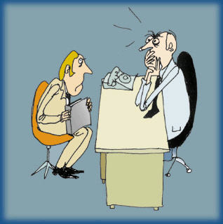


D R _ Text 1
Get the Job You Want
I run a manufacturing company with about 350 employees, and I often do the interviewing and hiring myself. I like talking to potential salespeople, because they’re our link to customers.
When a recent college graduate came into my office not too long ago looking for a sales job, I asked him what he had done to prepare for the interview. He said he’d read something about us somewhere.

Slide 3

D R _ Text 2
Had he called anyone at Mackay Envelope Corporation to find out more about us? No. Had he called our suppliers? Our customers? No.
Had he checked with his university to see if there were any graduates working at Mackay whom he could interview? Had he asked any friends to grill him in a mock interview? Did he go to the library to find newspaper clippings on us?

Slide 4


D R _ Text 3
Did he write a letter beforehand to tell us about himself, what he was doing to prepare for the interview and why he’d be right for the job? Was he planning to follow up the interview with another letter indicating his eagerness to join us? Would the letter be in our hands within 24 hours of the meeting, possibly even hand-delivered?
The answer to every question was the same: no. That left me with only one other question: How well prepared would this person be if he were to call on a prospective customer for us? I already knew the answer.

Slide 5
D R _ Text 4
As I see it, there are four keys to getting hired:
1. Prepare to win. “If you miss one day of practice, you notice the difference,” the saying goes among musicians. “If you miss two days of practice, the critics notice the difference. If you miss three days of practice, the audience notices the difference.”
When we watch a world-class musician or a top athlete, we don’t see the years of preparation that enabled him or her to become great. The Michael Jordans of the world have talent, yes, but they’re also the first ones

Slide 6
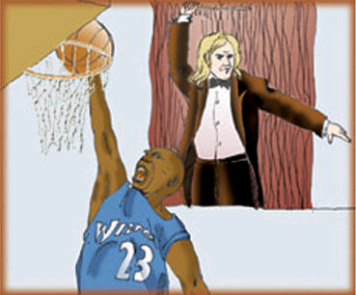
D R _ Text 5
ones on and the last ones off the basketball court. The same preparation applies in every form of human endeavor. If you want the job, you have to prepare to win it.
When I graduated from college, the odds were good that I would have the same job for the rest of my life. And that’s how it worked out. But getting hired is no longer a once-in-a-lifetime experience. Employment experts believe that today’s graduates could face as many as ten job changes during their careers.

Slide 7

D R _ Text 6
That may sound like a lot of pressure. But if you’re prepared, the pressure is on the other folks — the ones who haven’t done their homework.
You won’t get every job you go after. The best salespeople don’t close every sale. Michael Jordan makes barely half of his field-goal attempts. But it takes no longer to prepare well for one interview than to wander in half-prepared for five. And your prospects for success will be many times better.

Slide 8
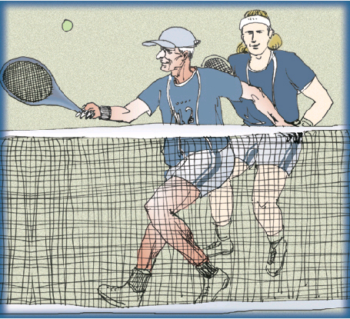
D R _ Text 7
2. Never stop learning. Recently I played a doubles tennis match paired with a 90-year-old. I wondered how things would work out; I shouldn’t have. We hammered our opponents 6-1, 6-1!
As we were switching sides to play a third set, he said to me, “Do you mind if I play the backhand court? I always like to work on my weaknesses.” What a fantastic example of a person who has never stopped learning. Incidentally, we won the third set 6-1.

Slide 9
D R _ Text 8
As we walked off the court, my 90-year-old partner chuckled and said, “I thought you’d like to know about my number-one ranking in doubles in the United States in my age bracket, 85 and up!” He wasn’t thinking 90; he wasn’t even thinking 85. He was thinking number one.
You can do the same if you work on your weaknesses and develop your strengths. To be able to compete, you’ve got to keep learning all your life.

Slide 10
D R _ Text 9
3. Believe in yourself, even when no one else does. Do you remember the four-minute mile? Athletes had been trying to do it for hundreds of years and finally decided it was physically impossible for humans. Our bone structure was all wrong, our lung power inadequate.
Then one human proved the experts wrong. And, miracle of miracles, six weeks after Roger Bannister broke the four-minute mile, John Landy beat Bannister’s time by nearly two full seconds. Since then, close to eight hundred runners have broken the four-minute mile!

Slide 11
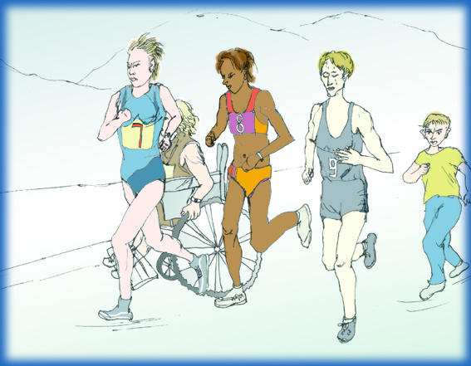
D R _ Text 10
Several years ago my daughter Mimi and I took a crack at running the New York Marathon. At the gun, 23,000 runners started — and 21,244 finished. First place went to a Kenyan who completed the race in two hours, 11 minutes and one second. The 21,244th runner to finish was a Vietnam veteran. He did it in three days, nine hours
hours and 37 minutes. With no legs, he covered 26.2 miles. After my daughter and I passed him in the first few minutes, we easily found more courage to finish ourselves.

Slide 12
D R _ Text 11
Don’t ever let anyone tell you that you can’t accomplish your goals. Who says you’re not tougher, harder working and more able than your competition? You see, a goal is a dream with a deadline: in writing, measurable, identifiable, attainable.
4. Find a way to make a difference. In my opinion, the majority of New York cabdrivers are unfriendly, if not downright rude. Most of the cabs are filthy, and almost all of them sport an impenetrable, bulletproof partition. But recently I jumped into a cab at LaGuardia Airport and guess what? It was clean. There was beautiful music playing and no partition.

Slide 13
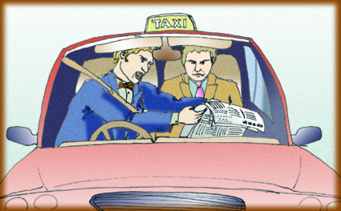
D R _ Text 12
“Park Lane Hotel, please,” I said to the driver. With a broad smile, he said, “Hi, my name is Wally,” and he handed me a mission statement. A mission statement! It said he would get me there safely, courteously and on time.
As we drove off, he held up a choice of newspapers and said, “Be my guest.” He told me to help myself to the fruit in the basket on the back seat. He held up a cellular phone and said, “It’s a dollar a minute if you’d like to make a call.”

Slide 14
D R _ Text 13
Shocked, I blurted, “How long have you been practicing this?” He answered, “Three or four years.”
“I know this is prying.” I said, “but how much extra money do you earn in tips?”
“Between $12,000 and $14,000 a year!” he responded proudly.
He doesn’t know it, but he’s my hero. He’s living proof that you can always shift the odds in your favor.

Slide 15
D R _ Text 14
My mentor, Curt Carlson, is the wealthiest man in Minnesota, owner of a hotel and travel company with sales in the neighborhood of $9 billion. I had to get to a meeting in New York one day, and Curt generously offered me a ride in his jet. It happened to be a day Minnesota was hit with one of the worst snowstorms in years. Minneapolis-St. Paul International Airport was closed for the first time in decades.
Then, though the storm continued to pound us, the airport opened a runway for small craft only. As we were taxiing down it to take off, Curt turned to me and said gleefully, “Look, Harvey, no tracks in the snow!”

Slide 16
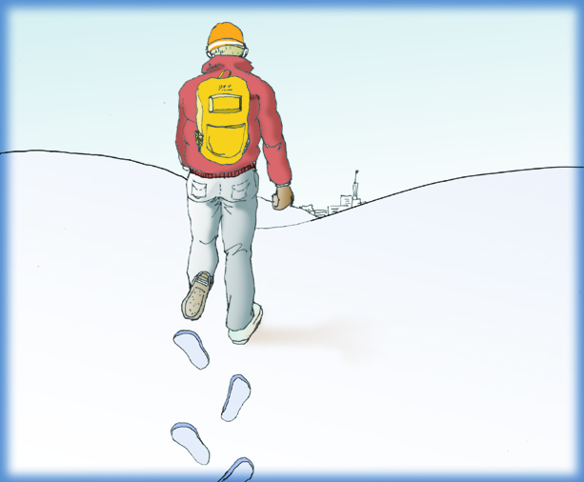
D R _ Text 15
Curt Carlson, 70 years old at the time, rich beyond anyone’s dreams, could still sparkle with excitement about being first.
From my standpoint, that’s what it’s all about. Prepare to win. Never stop learning. Believe in yourself, even when no one else does. Find a way to make a difference. Then go out and make your own tracks in the snow.

